Slide 1
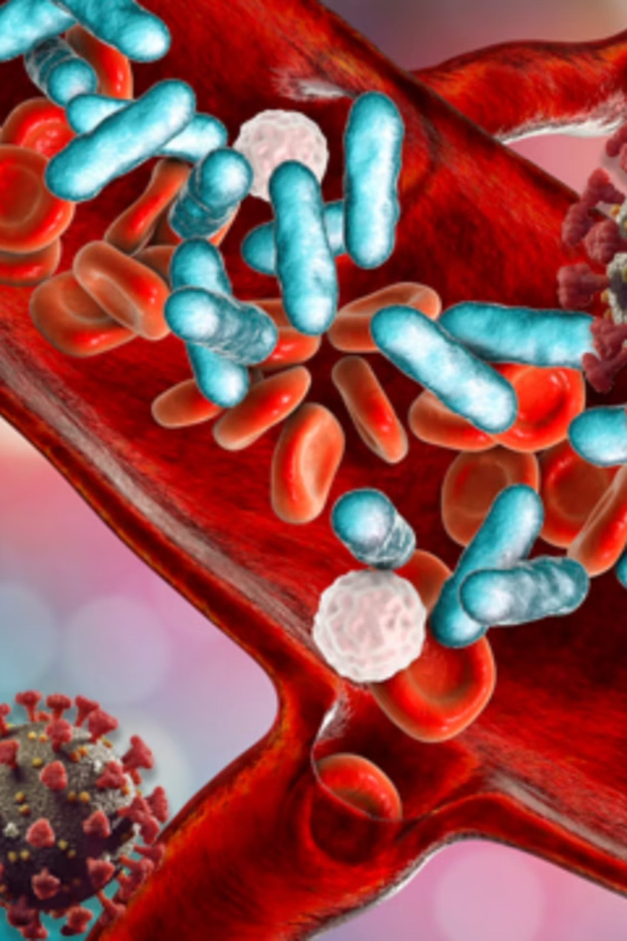
Accelerating Pathogen ( Sepsis ) Detection & Antimicrobial Stewardship
Current pathogen-sepsis detection workflows are too slow for optimal patient outcomes. NovaScope aims to dramatically reduce detection time from days to under an hour, transforming antimicrobial stewardship and patient care.

Slide 2
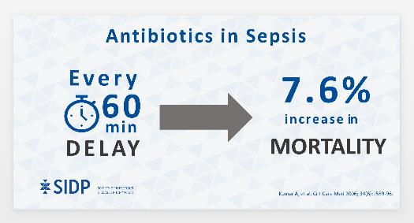
Unmet Needs for SEPSIS Diagnostics
Technology | Sensitivity | Turnaround time | Accessibility | Price
Conventional culture | N/A | 2-7 days | Central lab | US$20
MALDI-TOF MS | 10⁷ cfu/mL | 1 day | Central lab | US$50
BioFire FilmArray | 1-10⁵ TCID₅₀/mL | 1 day | Central lab | US$150-180
NOVASCOPE | 10³ cfu/mL | 60 mins | POCT or central lab | Competitive
Notes:
1 out of 2 to 3 hospital death is caused by SEPSIS. For every 60 minute delay, 7.6% increase in mortality. Current solution is to grow culture to identify the pathogens but it will take at least 24 hours even use the well-recognized tools like MS or flimarray.
Using Novascope technology, we can identify the cause and provide treatment suggestions in 30 minutes and able to save lives and reduce health care costs.
In addition to identifying bacteria, our platform can differentiate antibiotic resistance gene and variants, therefore we can provide physicians with best antibiotic use recommendation

Slide 3


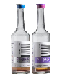

NOVASCOPE’s Fast and Accurate Test Result Enables Timely Treatment of Sepsis
Time to Result
Culture Independent
Diagnosis
Targeted Therapy
Detection limit: 10²-10³ cfu/mL
Anti-microbial resistance
Culture Dependent
Diagnosis
Conventional approach
Blood Culture
Pathogen Identification
(Filmarray, MALDI-TOF)
2-5 days
Detection limit: >10,000 cfu/mL

Slide 4
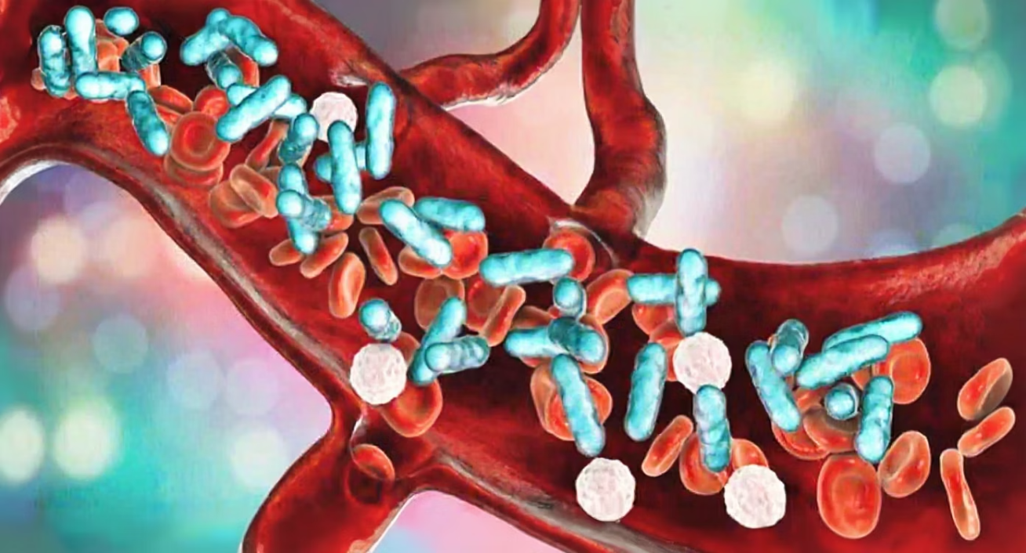
Clinical Validation Breakthrough: 98% Accuracy in Sepsis Detection
Our platform demonstrates a Limit of Detection (10² cfu/mL) that is orders of magnitude more sensitive than competing technologies.
Direct-from-Whole-Blood Detection Results
98%
97%
Overall Accuracy
Sensitivity
Detecting pathogens from non-cultured clinical samples
True positive rate in clinical testing
100%
<1hr
Specificity
Time to Result
Zero false positives in validation study
Enabling rapid clinical decision-making
Source: Chang Gung Memorial Hospital

Slide 5
Traction & Validation: Technology De-Risked, Performance Proven

Slide 6
Third-Party Validation- Cultured clinical whole blood samples
88 clinical samples (LinKou CGMH hospital).
Non-culture blood: Sens 97%, Spec 100%, Accuracy 96%.
Post-culture: Sens 97%, Spec 90%, Accuracy 96%.
Turnaround: <1h vs 2–5 days culture.
Conclusion: Validated in real-world samples.
The results of non-cultured clinical whole blood samples
 | Actual Positive | Actual Negative
Chip Result: Positive | TP = 33 | FP = 1
Chip Result: Negative | FN = 1 | TN = 9
Sensitivity: 97%
Specificity: 90%
Positive Predictive Value (PPV): 97%
Negative Predictive Value (NPV): 90%
Overall Accuracy: 96%

Slide 7
Third-Party Validation- Non-cultured clinical whole blood samples
Criteria
The results of non-cultured clinical whole blood samples
Sample Type | Evaluation Criteria | Cut-off
Non-cultured clinical whole blood samples | Sample shift steps > negative control | 18 steps
 | Actual Positive | Actual Negative
Chip Result: Positive | TP = 33 | FP = 0
Chip Result: Negative | FN = 1 | TN = 10
Sensitivity: 97%
Specificity: 100%
Positive Predictive Value (PPV): 100%
Negative Predictive Value (NPV): 91%
Overall Accuracy: 98%
Notes:
TS09-27-15: 晶片落點偏後，不穩定

Slide 8
Competitive IVD Landscape (Nucleic Acid)
Specification | BioFire BCID2 | T2 Bacteria Panel | Roche Eplex BCID | Vivalytic (BOSCH) | NOVASCOPE
Technology | Multiplex PCR | T2MR | AC Voltammetry | Multiplex PCR | FET / GFET
Specimen | Positive blood culture | Whole blood | Blood culture | Nasal or throat swab | Whole blood
Types of pathogen to be detected | 43 pathogens (incl. resistance genes) | 6 common bacteria | 56 pathogens (incl. resistance & fungi) | Single pathogen (S. aureus) | 7 common sepsis pathogens (e.g., E. coli, S. aureus)
Reaction time | ~1 hr | ~3–5 hrs | ~90 min | ~1 hr | <1 hr
Incubation time | Yes (12–24 hrs) | No | Yes (~12 hrs) | No | Current: <6 hrs; Goal: No incubation
Total testing | >1 day | <5 hrs | <15 hrs | <1 hr | Current: <8 hrs; Goal: <1 hr
Detection limit | E.f=1*10^5 cfu/ml E.c=5*10^5 cfu/ml K.p=5*10^4 cfu/ml P.a= 1*10^4 cfu/ml S.a=1*10^4 cfu/ml | E.f=5 cfu/ml; E.c=11 cfu/ml; K.p=2 cfu/ml; P.a= 5 cfu/ml; S.a= 2 cfu/ml A.b=3 cfu/ml | NA | NA | 1*10^3 cfu/ml
Resistance Gene | CTX-M, IMP, KPC, mcr-1a, mecA/C mecA/C and MREJ(MRSA), NDM, OXA-48-like, vanA/B, VIM | NA | CTX-M (blaCTX-M), NDM (blaNDM), IMP (blaIMP) , OXA (blaOXA), KPC , (blaKPC), VIM (blaVIM) | NA | CTX-M, IMP, KPC, mcr-1a, mecA/C mecA/C and MREJ（MRSA）, NDM, OXA-48-like, vanA/B, VIM
Specimen Pre-processing | Manual | Integrated (✓) | Integrated (✓) | Integrated (✓) | Integrated (✓)
Sensitivity | >90% | ~91–96% | >90% | NA (in development) | >90% (target)
Specificity | 97–100% | 99% | 97–100% | NA (in development) | >90% (target)
Global price (US$) | $150–180 / test | $300–450 / test | $180–220 / test | $100–150 / test | Target: <$100 / test

Slide 9


Pathogen (Sepsis) Platform – Roadmap
2025Q4
2026Q1
2026Q2
2026Q3
2026Q4
2027Q1
2027Q2
2027Q3
2027Q4
2028Q1
2028Q2
2028Q3
2028Q4
A strategic dual-track approach to regulatory approval: securing Class I registration while advancing Class II clinical validation for sepsis diagnostics.
TFDA｜E. coli Single Chip（Class I）
Registration & Market Launch
Class I Registration
Class II Apply
FDA Apply
透過一類與二類醫材雙軌策略，建立病原體（敗血症）檢測平台的法規與商業化路徑。
TFDA｜SP7 Multiplex（Class II）
TFDA｜E. coli ＆ SP7 AMR（Class II）
Chip 一類已經完成Listing
SP7 + AMR
US FDA｜Single Chip（Manual → Automated）
Single chip + Microfluidic
US FDA｜Multiplex（Manual → Automated ）
Classification | Code | Company Product | Chinese Name | English Name | Key Description (Summary) | Level | Special Regulatory Requirement
Class I | C.2660 ​ | Signal Chip ( E. coli )​ | 微生物鑑別及測定器材​ | Microorganism differentiation and identification device​ | Used for differentiation and identification of specific microorganisms to support clinical diagnosis; designed for single-analyte detection. | 1​ | Manufacturing site inspection required
 | A.2170 | Reader Angelica - E. coli | 臨床使用微量化學分析儀 | Micro chemistry analyzer for clinical use | Automated analyzer for clinical samples, integrating signal measurement and data processing; used with single-target detection chips.
Class II | C.3365 | SP7 Multiplex chip | 辨識陽性血液培養中微生物與抗藥性標記之多標的核酸檢驗試劑 | Multiplex nucleic acid assay for identification of microorganisms and resistance markers from positive blood cultures | Multiplex nucleic acid assay for simultaneous identification of multiple pathogens and antimicrobial resistance markers from positive blood cultures. | 2 | Performance validation and system-level review required
 | A.2570 | Reader Angeilca- SP7 Multiplex | 臨床多標的檢測系統儀器 | Instrumentation for clinical multiplex test systems | Integrated clinical testing system supporting multiplex detection, including signal acquisition, data processing, and result interpretation.

Slide 10
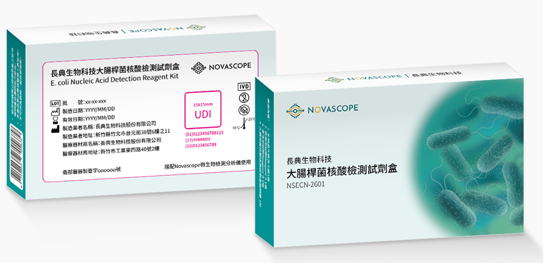
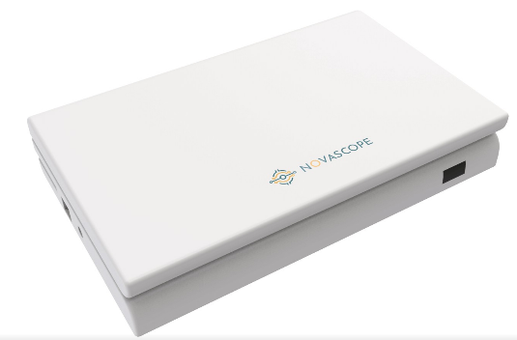
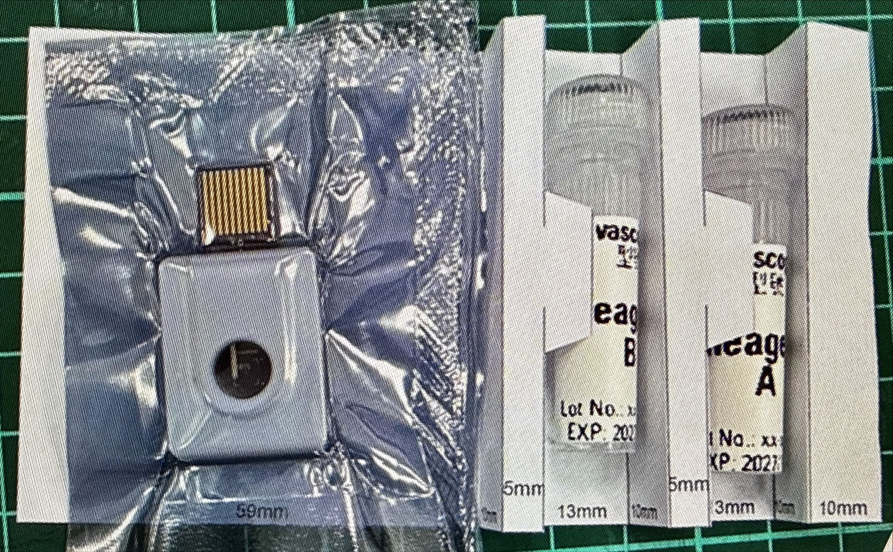
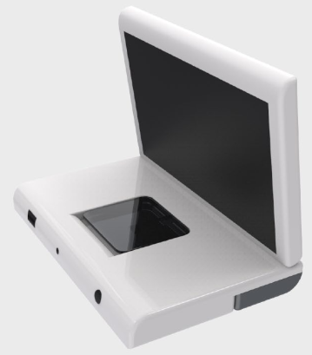
“長典”大腸桿菌核酸檢測試劑盒 Novascope NVDSense E. coli BioChip Assay Kit
A Class I molecular diagnostic solution for rapid E. coli identification
+
Detection System
Proprietary end-to-end system developed and owned by NOVASCOPE
Assay Kit
Reader
Integrated chip–reader system designed for sample-to-result clinical workflows

Slide 11
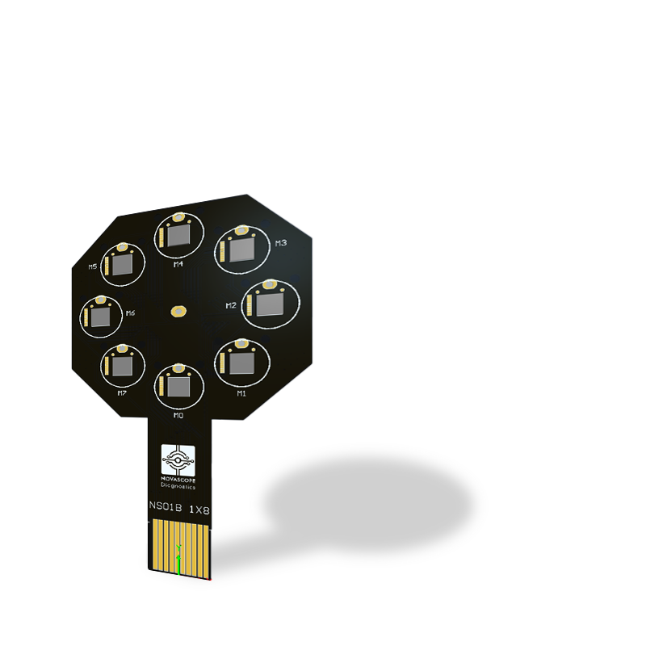
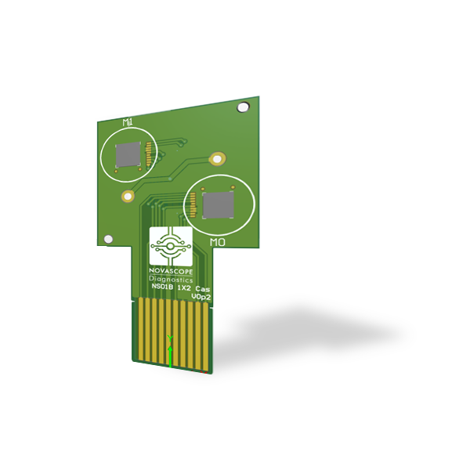
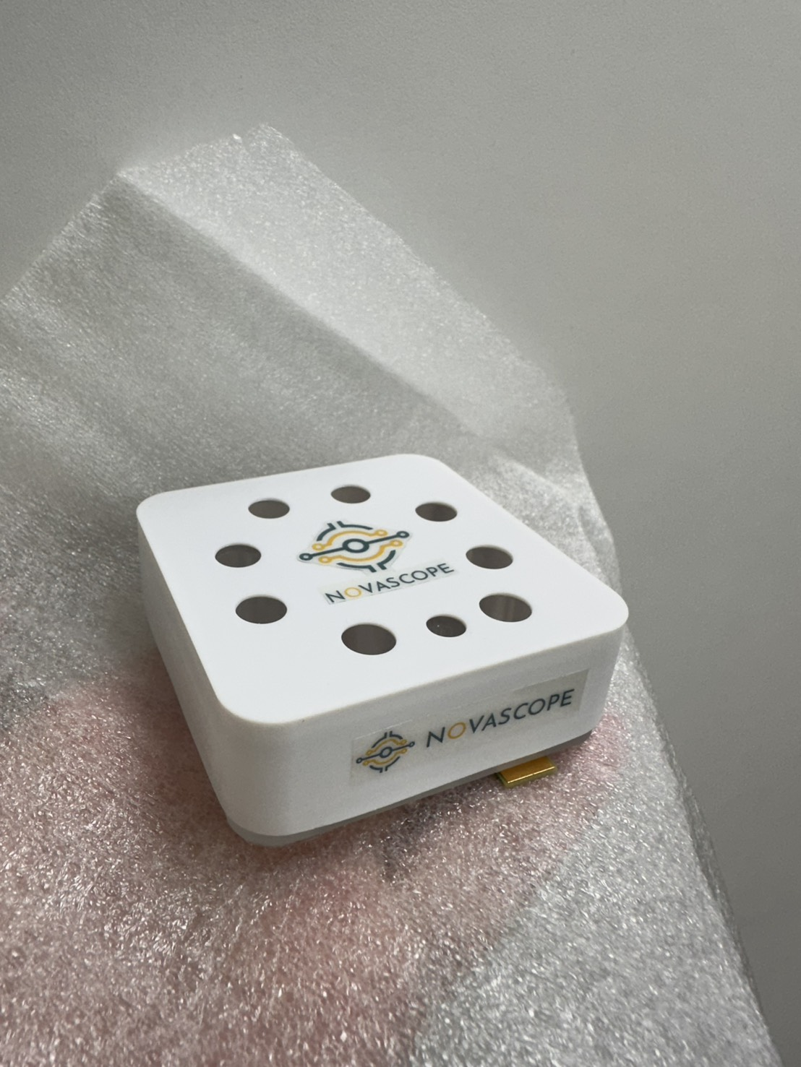
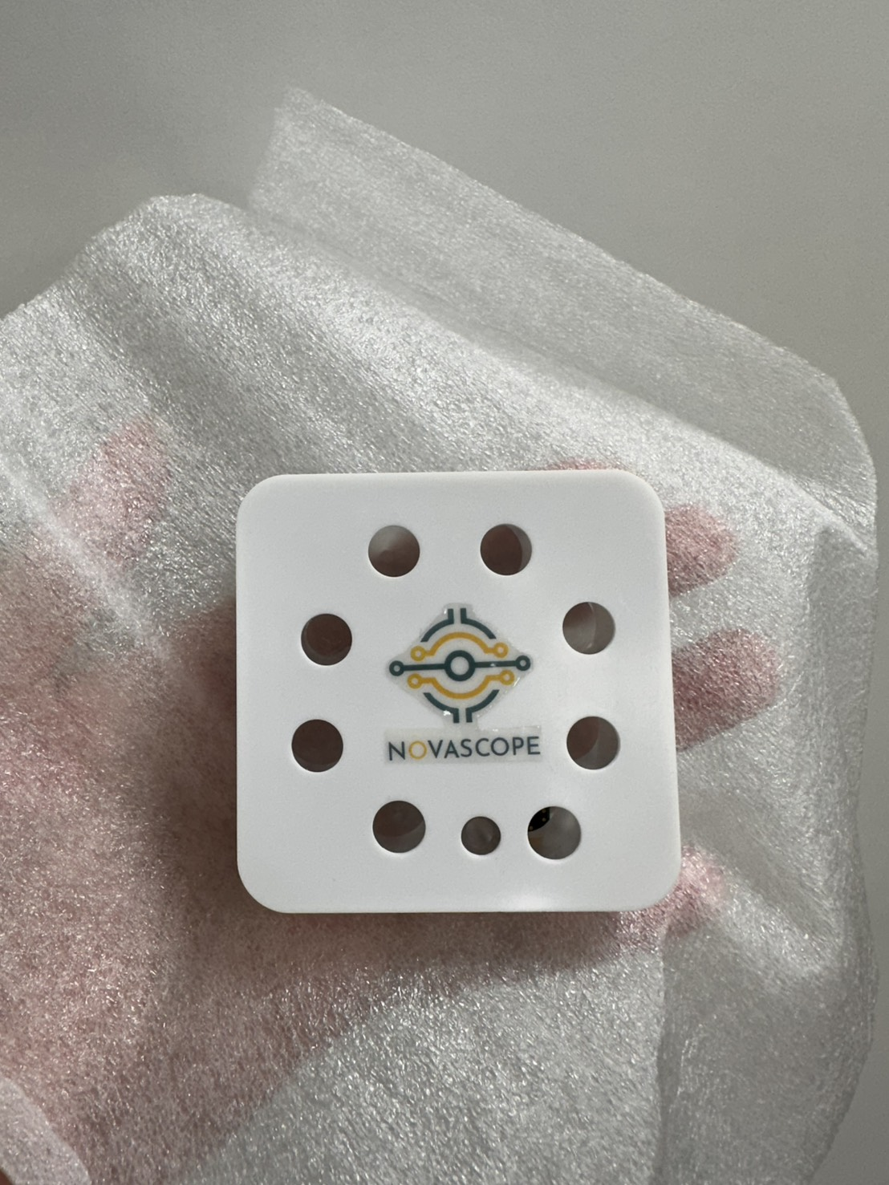
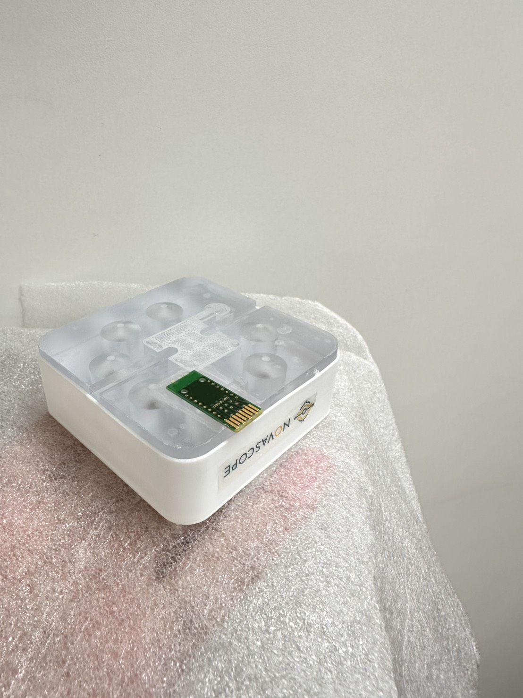
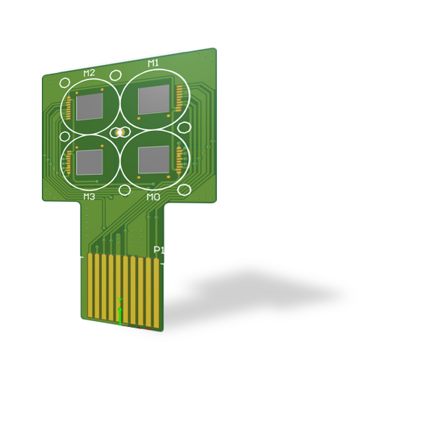
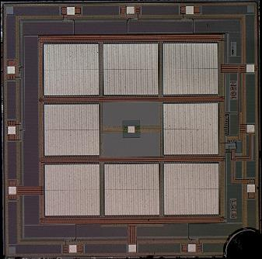
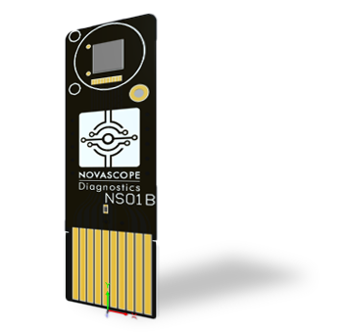
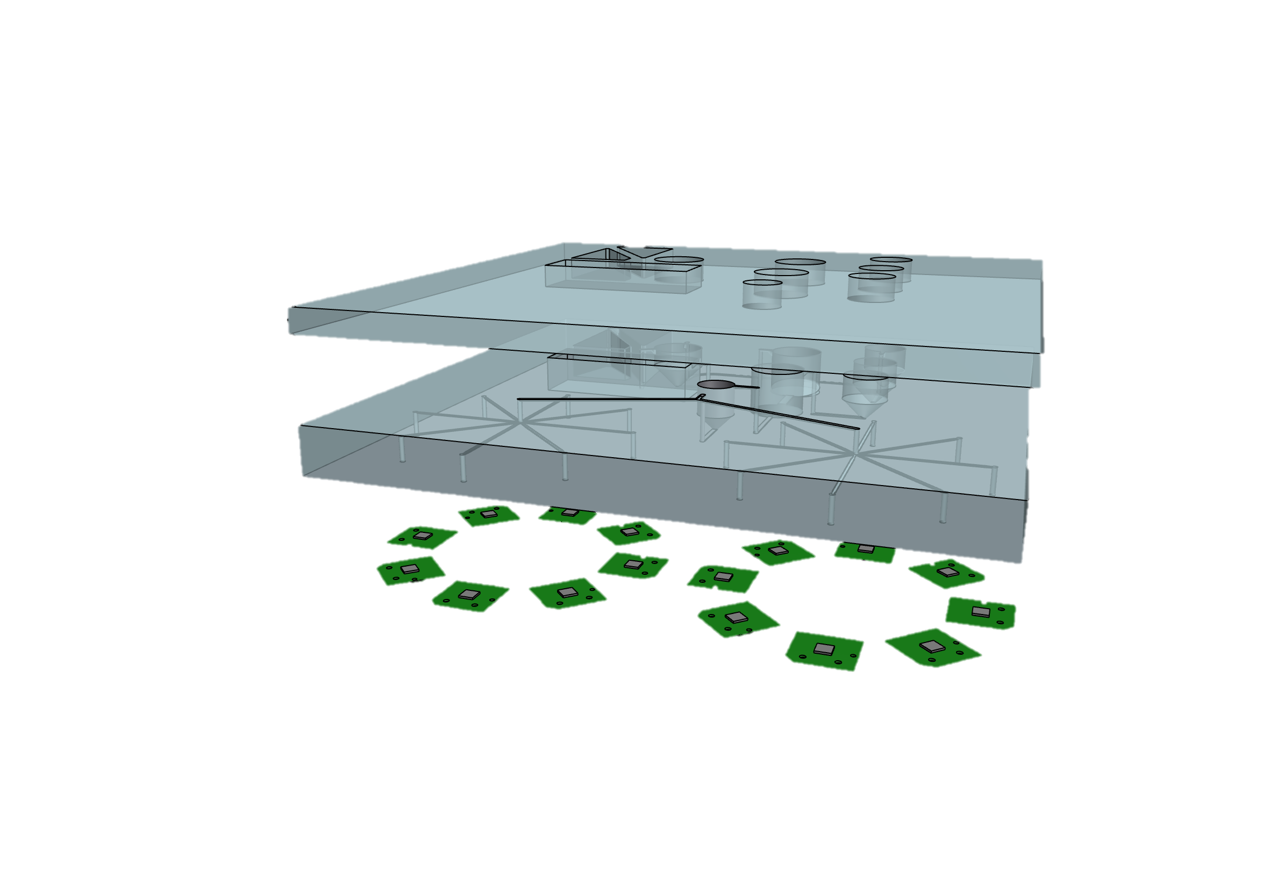
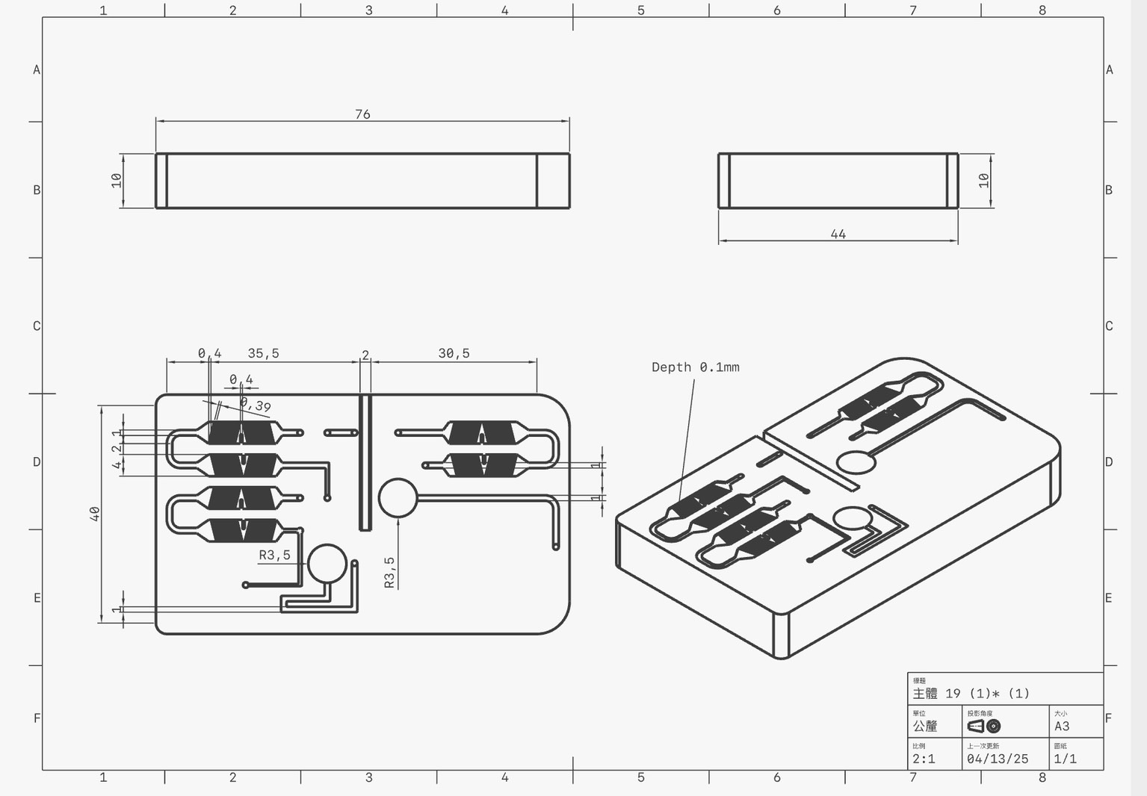
Microfluidic Integration as the Enabler for Class II & AMR Platform
Regulatory & Product Expansion (Class II / AMR)
Enables higher integration for Class II systems
Supports multiplex pathogen detection
Reduces workflow variability, strengthening clinical validation and AMR expansion
Investor Value Creation
Stronger platform differentiation with higher system-level entry barriers
Expanded product pipeline leverage with long-term margin upside

Slide 12
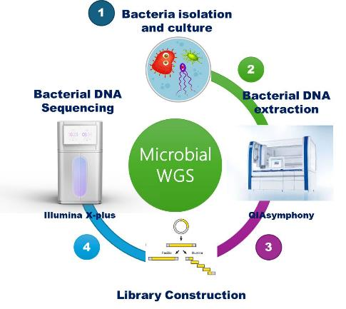
Nosocomial Pathogen Strain Bank and WGS Library Planning
Nosocomial infection bacteria
from Chang Gung memorial hospital
More than 700 bacterial isolations from near 3 decades
206 isolations are ready for following WGS
494 isolations are prepared for DNA extraction.
This strain bank and WGS library directly enable rapid probe design, panel optimization, and validation for Novascope’s pathogen and AMR biochip platforms.

Slide 13

Go-to-Market Strategy: Pathogen Identification (syndromic testing) Platform
Product | 2023 Revenue (approx.) | 2024 Revenue (approx.) | Notes
BioFire BCID2 | €1,334.9 million ^{[1]} | €1,494 million ^{[1]} | Includes multiple panels, major role in sepsis
T2 Bacterial Panel | $6.7 million ^{[3][4]} | $8.3 million ^{[3][4]} | Direct, specific sepsis panel revenue
Roche Eplex BCID | ~$50+ million | ~$50+ million | Market estimate, not separately disclosed
Initial Target
Deployment Model
Hospital central labs serving ICUs & ERs where <1 hour, culture-free test delivers highest value
Pilot programs & reagent rental agreements to minimize adoption barriers
Expanding Reach
Sample Sources
Blood: sepsis (Hospital-based)
Urine: urinary tract infection (Clinic-based)
UTI testing capabilities position for future GP & community settings
Saving Lives, Reducing Costs
Enable rapid, targeted antibiotic therapy
Reduce mortality rates & shorten hospital stays
Combat growing antimicrobial resistance

Slide 14


